Slide 1

Selenium Grid
SAROWER AHMMED

Slide 2
Selenium Grid
Cross Platform testing- run test in different operating system
Distributing test cases in multiple machine
Reduce test case run time
Possible to check multiple version of same browser

Slide 3


Slide 4
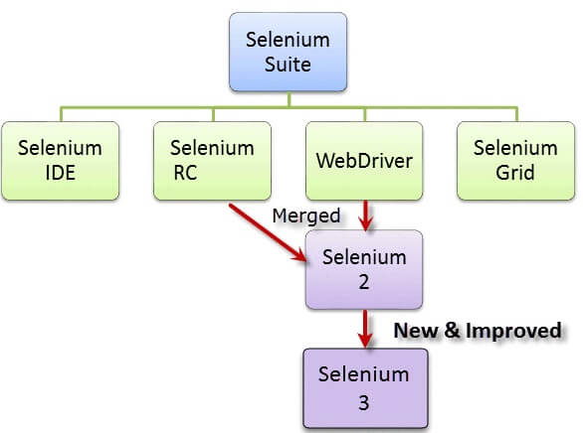
Selenium Grid is a part of the Selenium Suite

Slide 5
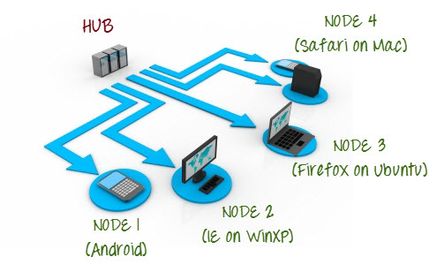
only run the test on a single machine called a hub, but the execution will be done by different machines called nodes

Slide 6
Selenium Grid Architecture
The Hub
central point where you load tests cases.
only one hub in a grid.
The hub is launched only on a single machine, say, a computer whose O.S is Windows 7 and whose browser is IE.
The machine containing the hub is where the tests will be run, but you will see the browser being automated on the node.
The Nodes
will execute the tests from hub.
There can be one or more nodes in a grid.
Nodes can be launched on multiple machines with different platforms and browsers.
The machines running the nodes no need the same platform as that of the hub.

Slide 7
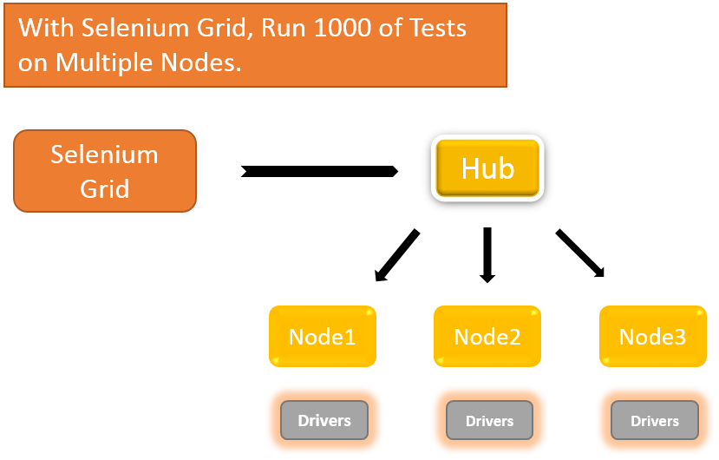

Slide 8
Selenium code from Eclipse
Browser open
Open Application
Open CMD
Start HUB
New session
Open CMD
Details test steps
Start NODE

Slide 9
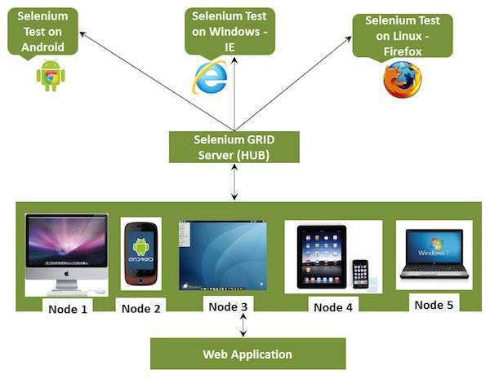

Slide 10
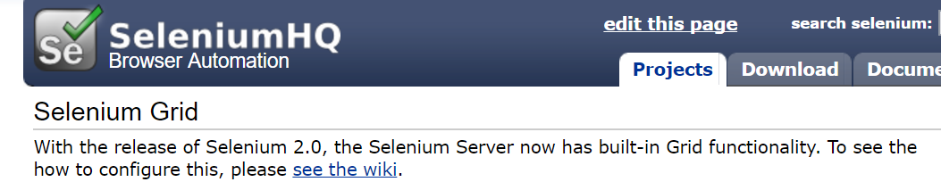
Selenium Grid has 2 versions
-the older Grid 1 and
the newer Grid 2.

Slide 11
Grid 1 | Grid 2
Selenium Grid 1 has its own remote control that is different from the Selenium RC server. They are two different programs. | Selenium Grid 2 is now bundled with the Selenium Server jar file
You need to install and configure Apache Ant first before you can use Grid 1. | You do not need to installApache Ant in Grid 2.
Can only support Selenium RC commands/scripts. | Can support both Selenium RC and WebDriver scripts.
You can only automate one browser per remote control. | One remote control can automate up to 5 browsers.

Slide 12
When/why to Use Selenium Grid?
Distribution test case in different machine
Run your tests against different
browsers,
Browser versions
operating systems
Save time in the execution of your test suites

Slide 13
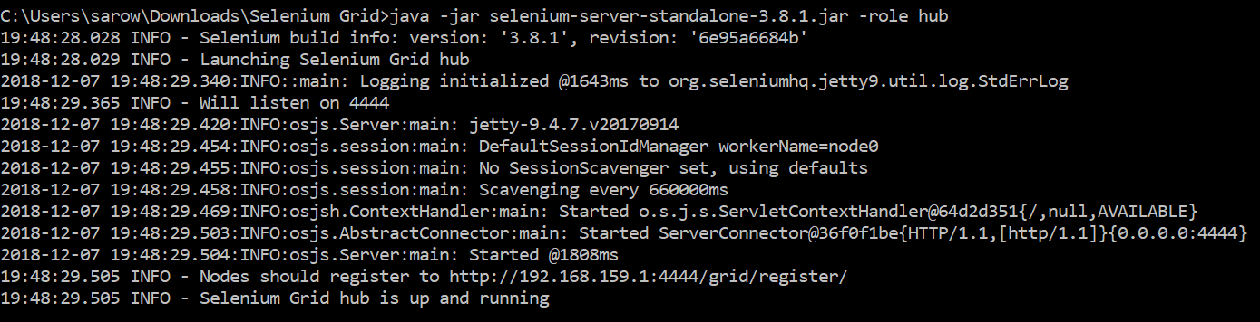
HUB CMD
java -jar selenium-server-standalone-3.8.1.jar -role hub

Slide 14
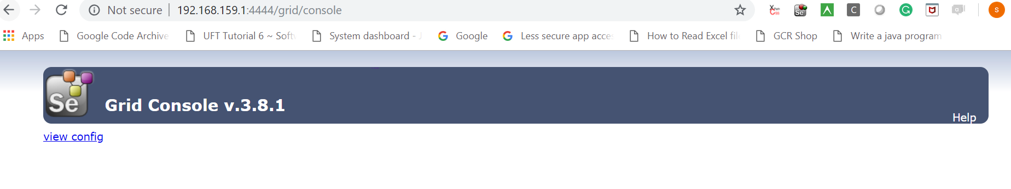
How to check hub connected
Open any browser in hub machine – no browser number
http://localhost:4444/grid/console

Slide 15

Tests from HUB
Run in node

Slide 16
Node
java -Dwebdriver.chrome.driver="C:\Users\sarow\git\DatadrivenFianl\DataDrivenProject\Driver\chromedriver.exe" -jar selenium-server-standalone-3.8.1.jar -role node -hub http://localhost:4444/grid/register
If same machine than localhost
If different machine http://192.168.1.3:4444/grid/register
192.168.1.3:4444➔ hub IP address

Slide 17
To open Another node
java -Dwebdriver.chrome.driver="C:\Users\sarow\git\DatadrivenFianl\DataDrivenProject\Driver\chromedriver.exe" -jar selenium-server-standalone-3.8.1.jar -role node -hub http://localhost:4444/grid/register -port 5555
Add code -port 5555

Slide 18
How to check Node connection
http://localhost:4444/grid/console

Slide 19
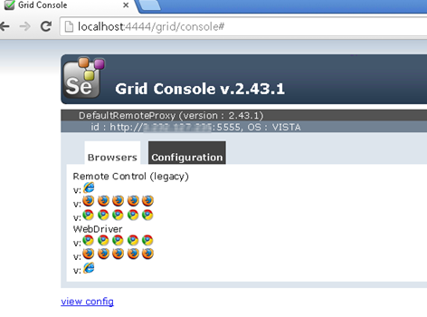

Slide 20
Selenium Test: From Hub
DesiredCapabilities capabilites = new DesiredCapabilities();
capabilites.setPlatform(Platform.WIN10);
ChromeOptions options = new ChromeOptions();
options.merge(capabilites);
String hubURL ="http://localhost:4444/wd/hub";
WebDriver driver = new RemoteWebDriver(new URL(hubURL), options);
driver.get("https://www.google.com");
driver.manage().window().maximize();
System.out.println(driver.getTitle());
driver.quit();

Slide 21
Configuring the nodes
The node can be configured in 2 different ways; one is by specifying command line parameters, the other is by specifying a json file.
By default, starting the node allows for concurrent number of browsers=11 browsers... : 5 Firefox, 5 Chrome, 1 Internet Explorer.
But The maximum number of concurrent tests is set to 5 by default.

Slide 22
Node parameter change from CMD
-browser browserName=firefox,version=3.6,maxInstances=5,platform=LINUX
-browser “browserName=firefox,version=3.6,firefox_binary=c:\Program Files\firefox ,maxInstances=3, platform=WINDOWS”

Slide 23
Grid Time out
Timeouts in the grid should normally be handled through webDriver.manage().timeouts(), which will control how the different operations time out.
driver.manage().timeouts().pageLoadTimeout(30, TimeUnit.SECONDS);
driver.manage().timeouts().implicitlyWait(30, TimeUnit.SECONDS);
-timeout 30 (300 is default) The timeout in seconds before the hub automatically releases a node that hasn't received any requests for more than the specified number of seconds. After this time, the node will be released for another test in the queue. This helps to clear client crashes without manual intervention. To remove the timeout completely, specify -timeout 0 and the hub will never release the node.

Slide 24
Jason parameter for node
Craete a json file as configuration file
Pass all parameter
Pass the file name in CMD
This is easy to configure what ever you want

Slide 25
parallel 10 browser instance - "maxSession": 10
Node code added json configuration like below- java -jar selenium-server-standalone-2.53.1.jar -role node -nodeConfig nodev2.json
Write a configuration file in json
{ "capabilities": [
{ "browserName": "chrome",
"maxInstances": 10,
"seleniumProtocol": "WebDriver" } ],
"configuration": {
"proxy": "org.openqa.grid.selenium.proxy.DefaultRemoteProxy",
"maxSession": 10 }}

Slide 26
How to shut down hub
http://localhost:4444/selenium-server/driver/?cmd=shutDownSeleniumServer
Short cut ctr+c

Slide 27
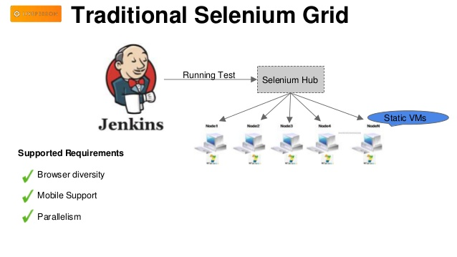

Slide 28
Jenkins with Grid
Jenkins has the ability (via the Selenium Plugin) to run a local standalone Selenium server. You can use multiple Jenkins slaves to parallelize testing (on a per-job basis.)
Selenium Grid allows you to separate Selenium execution from from Jenkins and you can paralellize execution of tests in a single Jenkins job.

Slide 29
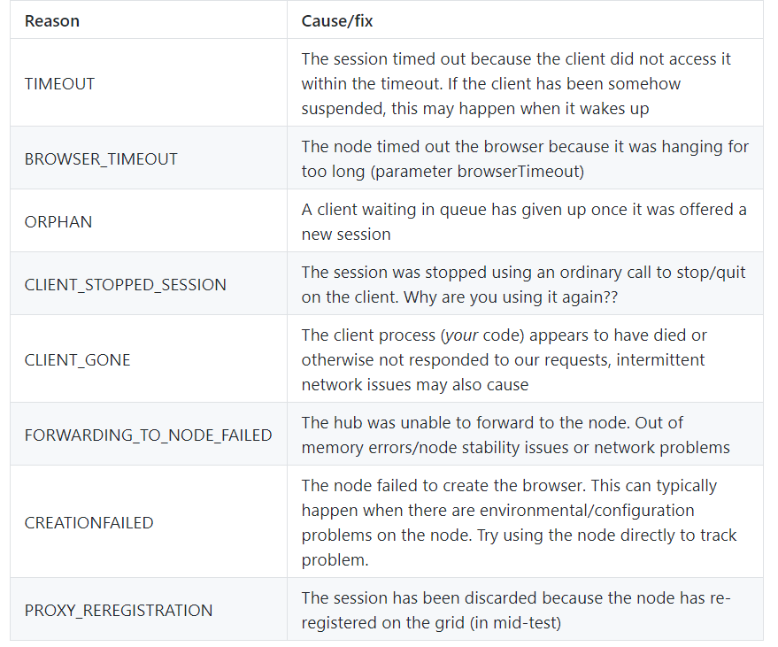

Slide 30
Questions
Why you need selenium grid?
Difference between Grid1 vs Grid2
Difference between Hub vs Node
How to setup grid?
How you know as hub and node connected?
What is a hub and node criteria?
Check difference
How you know as node is not compatible for hub?
If none of the node are compatible then you can see error msg in Hub CMD console

Slide 31
questions
What is default browser setup?
By default, starting the node allows for concurrent number of browsers=11 browsers... : 5 Firefox, 5 Chrome, 1 Internet Explorer.
But The maximum number of concurrent tests is set to 5 by default.
What is the meaning of timeout 30 ?
How to fix delayed time out?
Use implicit wait code and time 0 to 30 sec

Slide 32
Where to see report
Detailed steps can be seen in node
But Testng default report will seen in Hub

Slide 33


